Slide 1
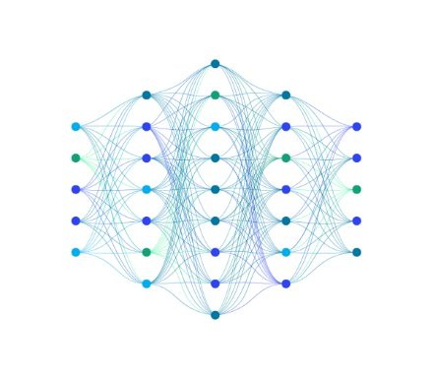
Problem Statement: Create a Fitness Tracker!
Fitness trackers are used to track health data as you live your everyday life. From simple calculations to AI models, they turn your data into useful metrics. In this challenge, you will use MATLAB and MATLAB Mobile to make your own fitness tracker!
Output could include any sort of fitness data such as calories burned, distance walked
If possible, these models should utilize machine learning techniques.
You will need to present your tracker

